Slide 1
Phonics at Staplehurst School Mrs Golding EYFS Phase Leader

Slide 2
Aims of the session
To have a secure understanding of how we teach phonics at Staplehurst School
To understand the importance of pure sounds
To have a clear understanding of the terminology used when teaching phonics
To see resources used in school to reinforce phonics teaching

Slide 3
Where does phonics fit into reading?

Slide 4
Phonics Key Vocabulary
Phoneme - the smallest unit of sound
Grapheme - a letter or group of letters that represents a single phoneme
Digraph – 2 letters representing one sound
Trigraph – 3 letters representing one sound
Blending – combine sounds to make a word for reading
Segmenting – separate a word into individual words for writing

Slide 5
What is Read Write Inc?
Systematic synthetic phonics scheme – validated by DfE
Teaches
single letter sounds
Digraphs (2 letters make one sound) – ‘special friends’
Trigraphs (3 letters make one sound) – ‘special friends’
Blend sounds to read c-a-t
Segment sounds for writing
Whole class initially – later moves to groupings
based on assessments.

Slide 6
Importance of ‘pure sounds’
Pure sounds - 'mmmmmm' not 'muh'
M-a-x
Must use shortest unit of sound
Stretchy sounds – s, m, l, r, f, v, n, z
Bouncy sounds – t, d, p, g, o, u, c, y, w, b, j,
Refer to sound not letter name - 'a' not 'A (ay)'
Supports reading and writing

Slide 7
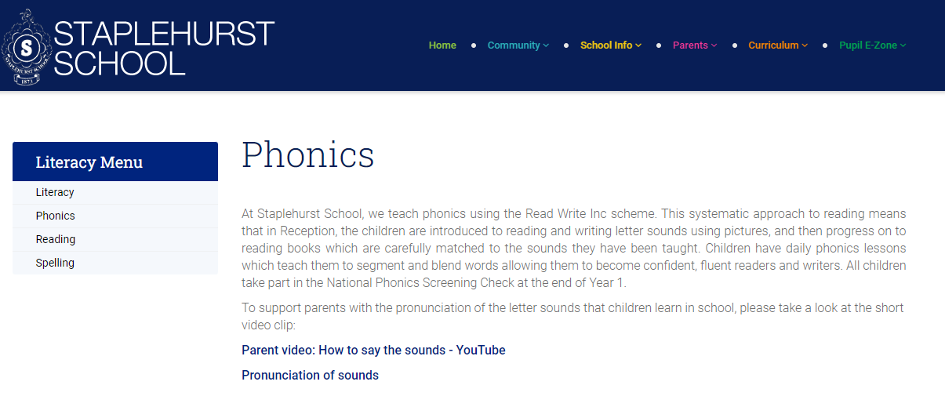
Website – pronunciation video Staplehurst School – Phonics

Slide 8
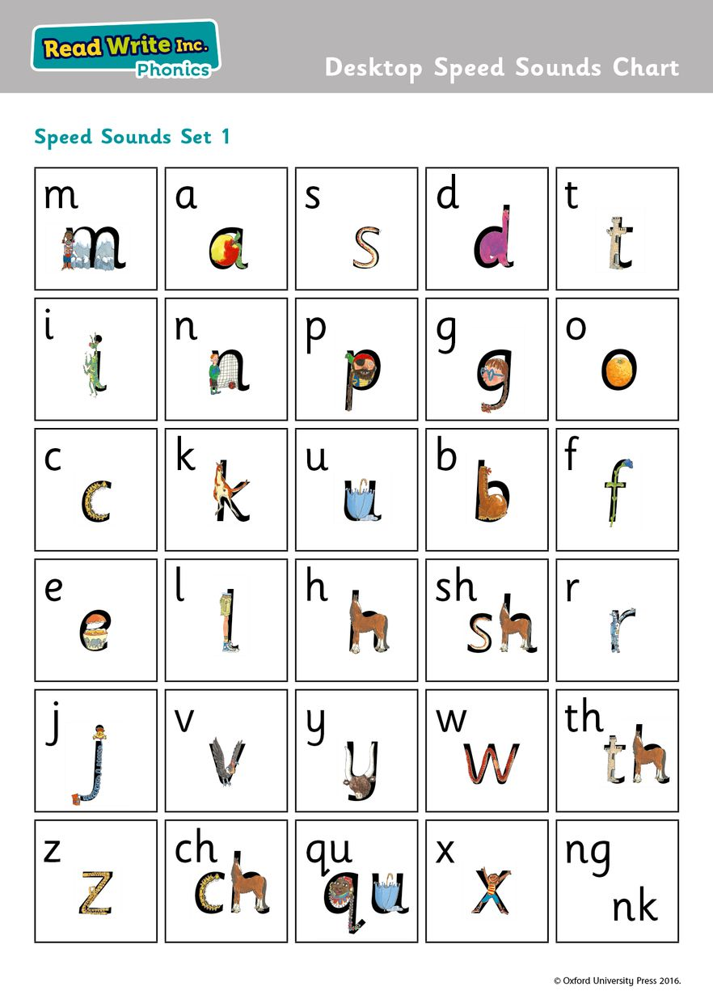
RWI set 1 sounds

Slide 9
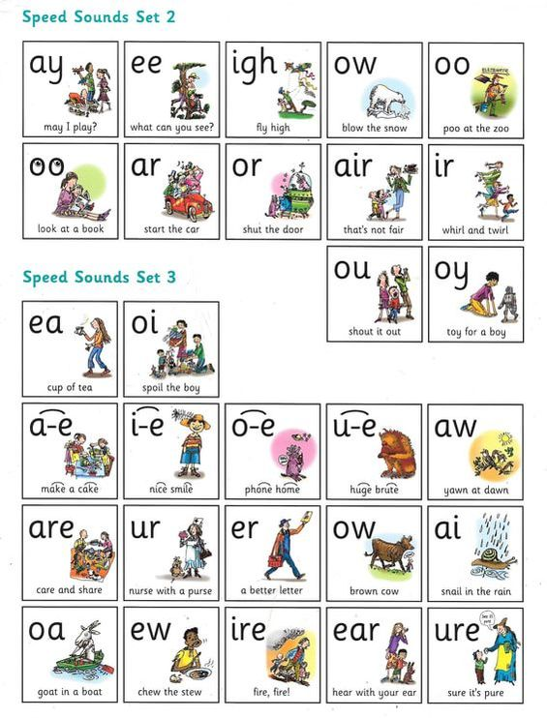
RWI set 2 and 3 sounds

Slide 10
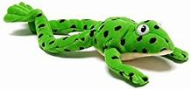
Set 1 lesson template
Picture cards
Introduce sound – link with image e.g. ‘a’ → apple
Recap sounds learnt – add today’s sound to pack
‘Fred talk’ – say the sounds
Green words
3 step process for word reading
Look for ‘special friends’
Fred talk the sounds
Read the word – blend the sounds together

Slide 11
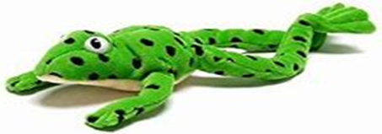
‘Fred fingers’ for spelling words
Pinch the sounds on fingers
How many sounds
Write the sounds you can hear in the word
Initial sound
Final sound
Medial sounds

Slide 12
RWI Books – for in phonics lessons
Termly assessment shows what level RWI book is appropriate
Read in lessons time x 3
Linked with sounds already
learnt
Builds fluency and automaticity

Slide 13
Red Words tricky words/common exception words
Taught within lessons as part of books
Recap regularly
Identify parts of word that are decodable
To be sent home as part of homework.

Slide 14
Year 1 Phonics Screening Check
Term 6 of Year 1
Ensure all children reach a good standard of phonic knowledge for decoding
Children read 40 words
Real words
‘alien’ words – not real
Pass mark 32/40

Slide 15
Ways to help your child
Recap sounds learnt
Within homework folder weekly – remember to use pure sounds
Listen to them read school book
Carefully matched to their phonic knowledge
3 step process – Special friends, Fred talk, Read the word
Read it more than once – builds fluency and word recognition
Read to them
Library book weekly to share
Books from home
Develop love of reading through personal book choice
Exposes them to wider vocabulary

Slide 16
Ways to help your child
Reading Log – checked on Tuesdays and Fridays
For recording reading only
Other messages to be sent via year group emails or to office if urgent
Initially wordless books– tell the story orally through the pictures
Trust phonics
Have patience

Slide 17
Explore some phonics resources
These are some of the activities we use within exploring time to reinforce phonics teaching.

