Slide 1
PSHE Safety and the Changing Body
Respecting personal boundaries.

Slide 2
Our PSHE rules:
Respect other people’s ideas
There are no silly questions
We don't share stories or information that is shared- unless someone is unsafe.
That we’re all different and that’s fine

Slide 3
Vocabulary
boundary
choice
contact
decision
permission
personal
uncomfortable

Slide 4
Key questions
What is the PANTS rule?
What are the private parts of our bodies called?
Who does your body belong to?
What is a safe touch?
What might be an unsafe touch?
What can we do if someone is touching us in a way we do not like?

Slide 5
I will know...
I can choose what happens to my body.
I know I can give permission and take it away when I choose.
I know who to talk to if I feel uncomfortable.

Slide 6

Let's watch!
NSPCC PANTOSAURUS 2017 SUBTITLED... - VideoLink.

Slide 7
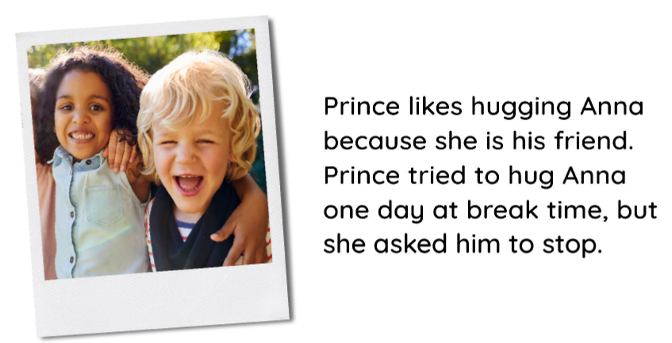

Slide 8
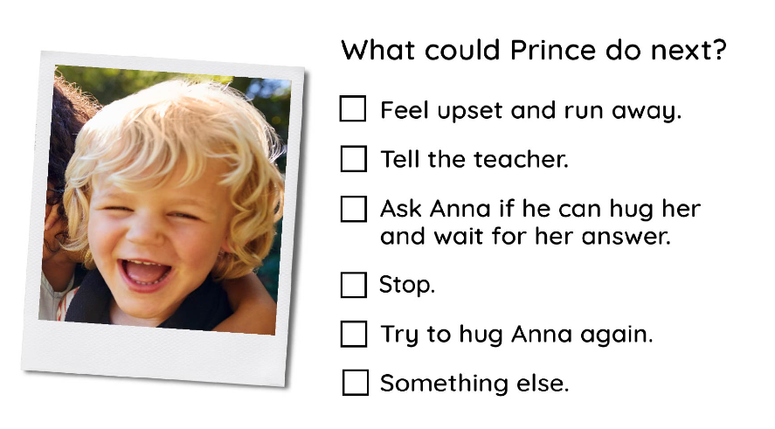

Slide 9
Let's read the story...
Read the story ‘I choose to say no,’ by Elizabeth Estrada and ask the following questions regarding personal consent, safety and private parts:
What are the ways that we can say ‘no’ to someone respectfully? (Examples could include: Not today, I don’t like that, no thank you, let’s fist bump instead.)
Can we change our mind about giving permission to someone? (Yes. This also includes online permission, such as sharing a photo or information.)
Who is in your ‘circle of trust?’
What signs can you look out for that show you feel unsafe? (Heart beating fast, breathing slowing, dizziness, worrying, fearful, butterflies in your tummy.)
Do you have a choice in saying no?

Slide 10
Let's talk about the story.
A ‘body boundary’ is a special invisible, personal space around us that we all can control. Even though it is an invisible space, it is there. It allows us to feel safe and secure. No one should come inside your body boundary without you saying it is okay. We let lots of people into our body boundaries every day, in lots of different contexts.
When have you made physical contact with someone today?

Slide 11
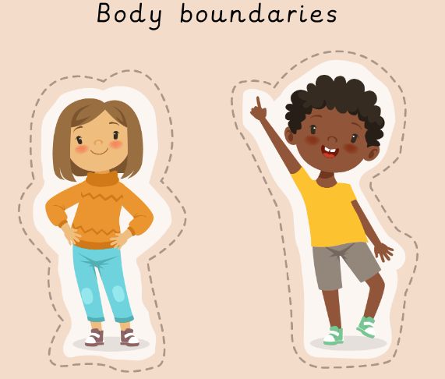
Map out our body boundaries.

Slide 12



Group task- Answer the questions.
Should we always let people into our body boundary?
What should we do or say if we change our mind?
How can you tell if someone doesn’t like it when you get close?
How can we respect other people’s wishes for body boundaries?

Slide 13
Question
If you ask someone to ‘stop’ and they do not listen to your wishes, what should you do?

